Slide 1
Databases
Ahmed Hesham

Slide 2
Why Use Databases?
Provide a permanent storage area for user data
Allow for metrics to be calculated from data
Allows for fast access to data as it is structured on disk

Slide 3
Types Of Databases
SQL: first generation databases
  Tabular
  Complex querying
  Records stored after each other on disk
NoSQL: second generation databases
  Can be non tabular
  Larger scalability
  Simple querying

Slide 4

How to Choose The Correct Type?

Slide 5
SQL Databases Pros:
Consistent
Complex operations e.g. joins and grouping

Slide 6
SQL Databases Cons:
Requires a thread pool in highly concurrent environments to avoid I/O overloading
Data needs to be normalized
Not suited for big data
Rigid

Slide 7
NoSQL Databases Pros:
Transparent data sharding
Suited for big data
Exists in many forms

Slide 8
NoSQL Databases Cons:
Limited operations
No constraint validation

Slide 9
NoSQL Database Types – I
Key-Value: data is stored as a hashmap
Use cases:
  Data with low complexity, where fast look up is required
Document based: data is stored as JSON documents (collection of hashmaps)
Use cases:
  Detailed standalone information about an item
  Where no joins are required

Slide 10
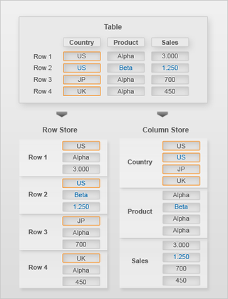
NoSQL Database Types – II
Column: data is in a tabular form, however they are stored as consecutive columns rather than rows
Use cases:
  Array processing, most commonly used for metric calculation and machine learning

Slide 11
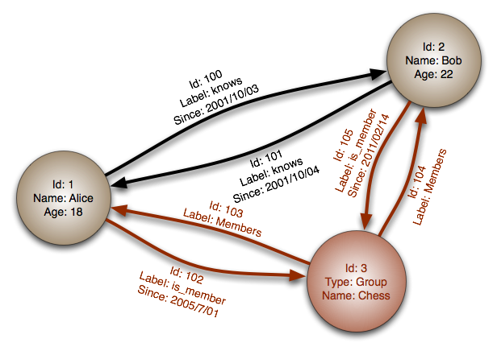
NoSQL Database Types – III
Graph: data is stored as a relationship graph on disk
Use cases:
  Data has a large number of relations to other data. Joins are modeled as the edges between nodes
  searching and recommendation systems

Slide 12

New Contenders

Slide 13
NewSQL
Hybrid between SQL and NoSQL
No specific standard, each implementation has specific use case

Slide 14
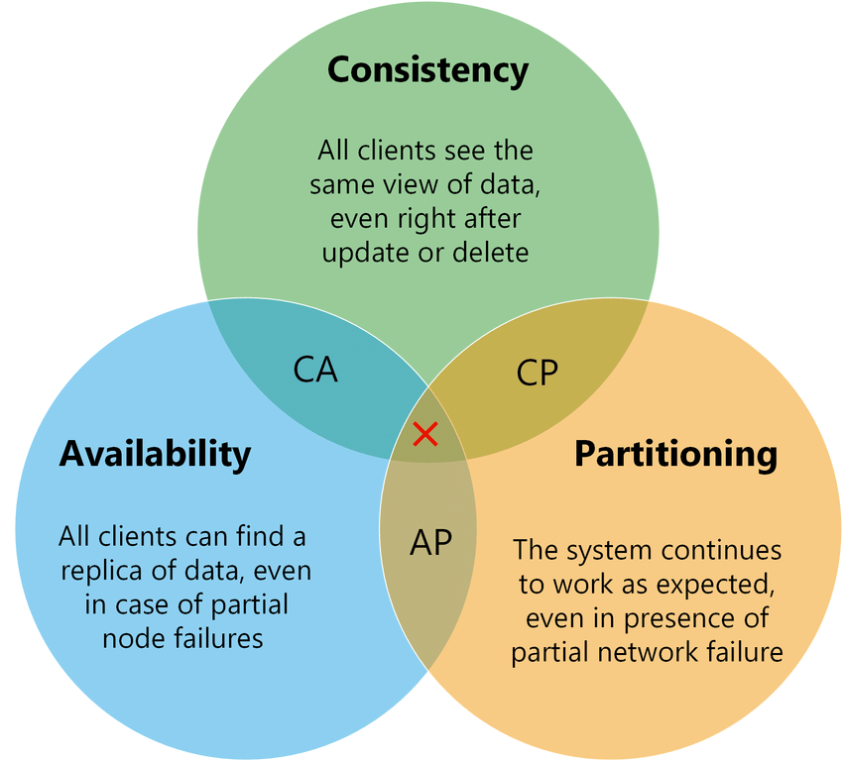
CAP Theorem

Slide 15
Temporal Databases
What are temporal databases?
  They are a new way to manage data
Data isn’t deleted for archiving purposes
Keeps track of insertion and deletion dates

Slide 16
Temporal Databases – II
Temporal databases keep track of:
  Valid time: the time period during which a fact is true in the real world
  Transaction time: the time period during which an item stored in the database was known
  Decision time: the time period during which a fact stored in the database was decided to be valid

Slide 17
Temporal Databases – Time Axis
Temporal databases exist in 3 forms:
  Uni-temporal: one axis of time (valid or transaction)
  Bi-temporal: two axes of time (valid and either transaction or decision)
  Tri-temporal: three axes of time (all three types)

Slide 18
Uni-Temporal Example – Storing Address
Assume you want to store address of people in the following table:
  Person(ID, Name, Address, Creation Date)
To log changes in address, the table becomes:
  Person(ID, Name, Address, Valid From, Valid Till)

Slide 19
Bi-Temporal Example – Storing Address
If person changes address we have to enter a new record
No way to know when updates happened
To keep track of previous addresses and updates, we add two more columns, thus table becomes:
  Person(Name, Address, Valid From, Valid Till, Entered, Last Update)

Slide 20
Tri-Temporal Example – Storing Address
Usually not used due to the complexities of handling the time constraints

Slide 21
Any questions?

